Slide 1
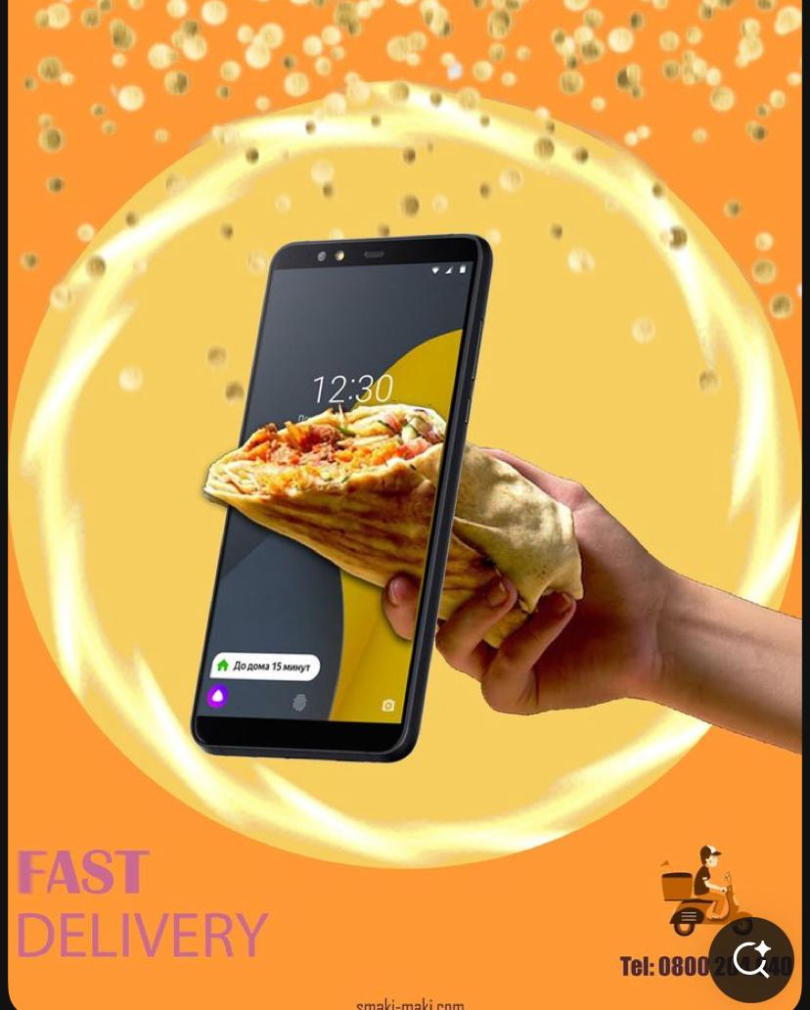
Online Food Ordering System
Problem Definition: Customers face long wait times and errors in traditional ordering
methods, Restaurants struggle with manual order management and payment tracking , A
digital PL/SQL-based system can streamline food ordering, payments, and deliveries.
context: Used in restaurants, cafes, and food delivery services, Customers, restaurant
owners, and delivery personnel will interact with the system.
Target Users: Customers (order food),Restaurants (manage menus & orders),Delivery
personnel (track deliveries), Administrators (oversee operations).

Slide 2
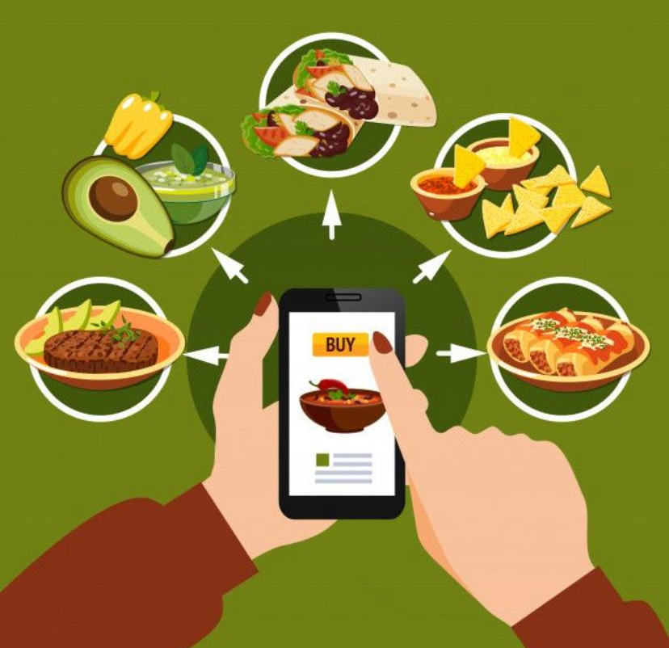
Main Entities & Relationships
Entities:
Customers (customer_id, name, contact, address)
Restaurants (restaurant_id, name, location, menu_id)
Orders (order_id, customer_id, restaurant_id, total_amount, status)
Menu Items (item_id, restaurant_id, name, price, availability)
Payments (payment_id, order_id, amount, method, status)
Delivery Personnel (delivery_id, order_id, name, contact, status)
Relationships:
A customer can place multiple orders.
A restaurant has multiple menu items.
An order is linked to a payment and a delivery personnel.

Slide 3
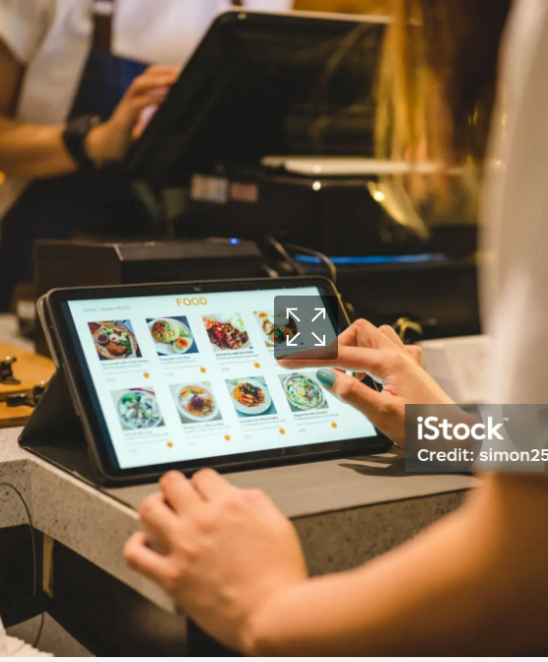
Anticipated Benefits
Automates Order Management → Reduces errors and delays.
Improves Data Security → Uses PL/SQL stored procedures & triggers for secure transactions.
Enhances Customer Satisfaction → Real-time order tracking & faster delivery.
Provides Business Insights → Reports on sales, most-ordered items, and delivery performance.
NAME: Uwera Maggy
ID: 27519
GROUP:B

